Slide 1
WELCOME TO
VITACEL

Slide 2
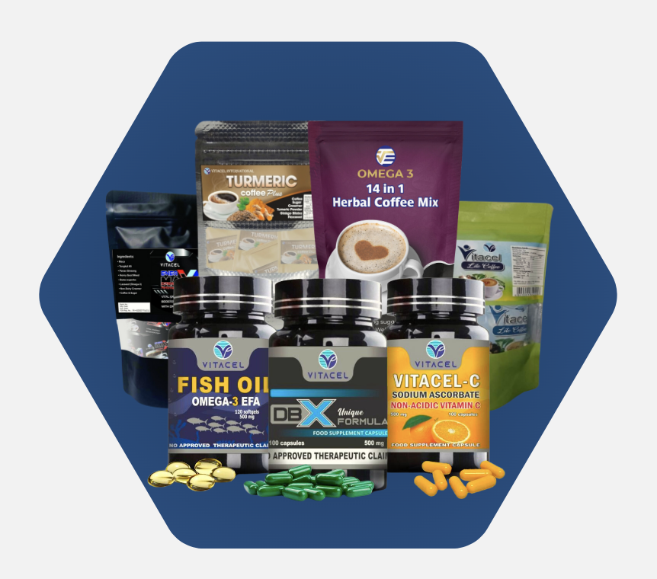
VITACEL
PRODUCT
PRESENTATION
Presented By:

Slide 3
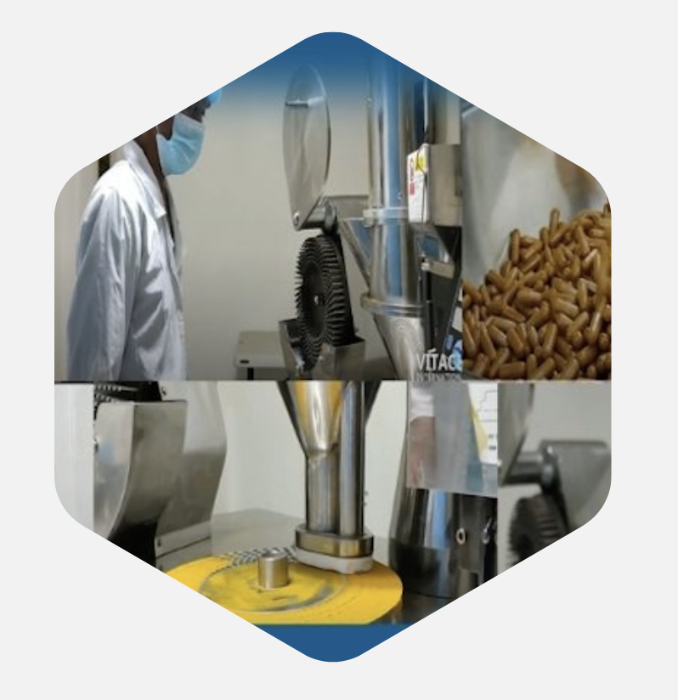
Company Overviews
Vitacel, has a remarkable journey that began in 1996. Initially, we laid the foundation as a manufacturing and distribution company known as Vitacel International, specializing in high-quality health and wellness products. In the year 2020, we took an exciting step forward by embracing the world of multi-level marketing (Network-Marketing). Our MLM approach enables us to empower our members not only to experience the benefits of our products but also to share these benefits with others while building their own businesses.

Slide 4
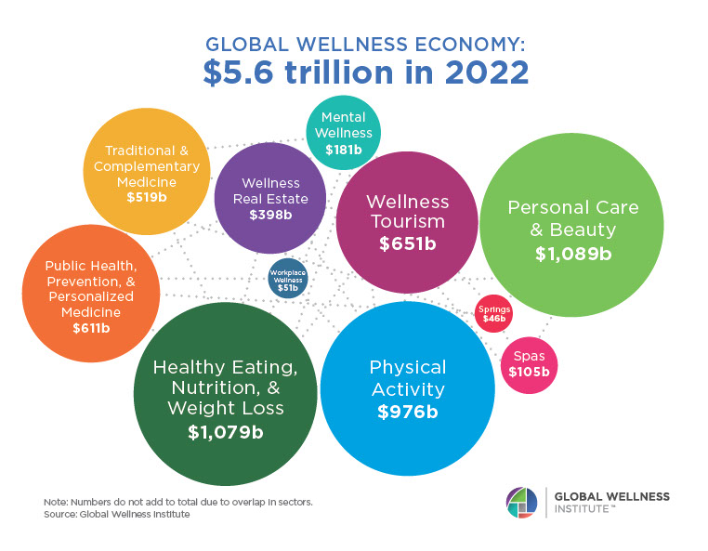
VITACEL
HEALTH & WELLNESS INDUSTRY
$8.5 trillion in 2027

Slide 5
DID YOU KNOW?
Leading cause of Death in the Philippines
Cardio Vascular Disease
1
Cerebrovascular Disease
2
Cancer
3
Diabetes
4
Chronic Lung Disease/Pneumonia
5

Slide 6
Why People Get Sick?
SUGAR
TRANS FAT
Stress
Lack of Sleep
Ageing
Vices/Bisyo
Unhealthy Foods

Slide 7
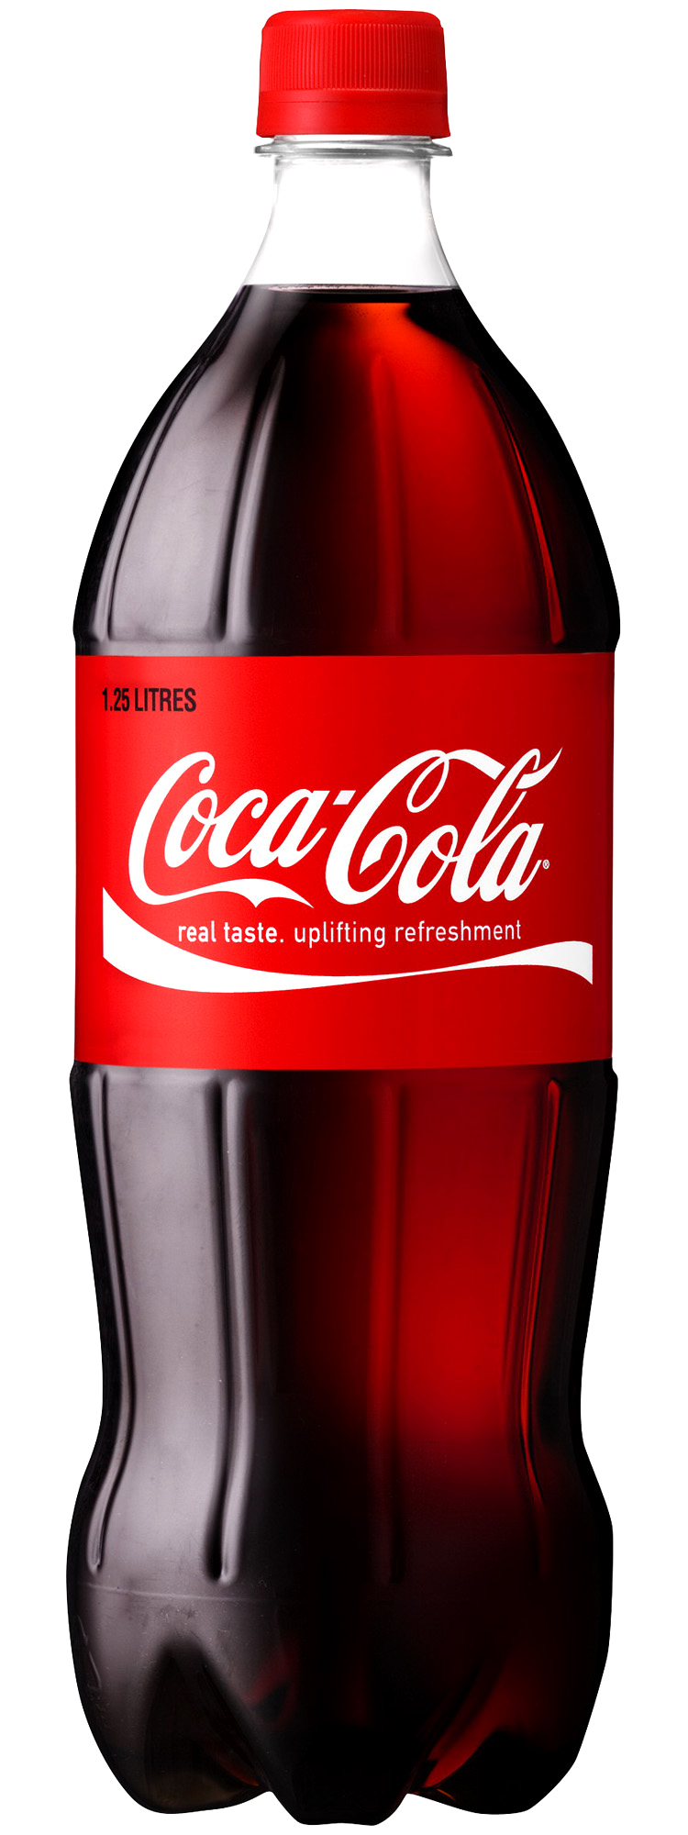
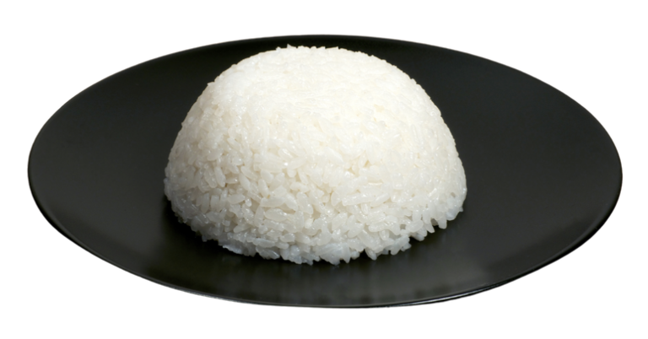
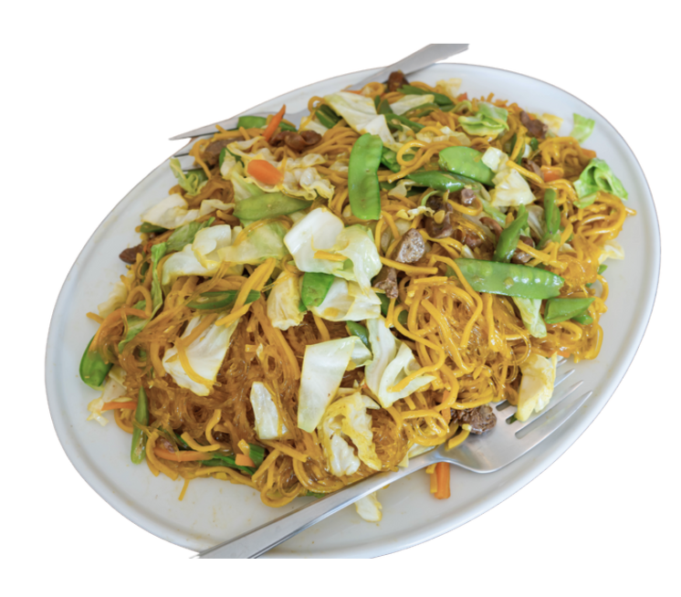
PINOY EATING HABIT
CARBOHYDRATES ADDICT
Hunger
Cravings
Eat
Carbs
The “CARB
ADDICTION”
Cycle
Low Blood
Sugar
High Blood
Sugar
Body Fat
Production
Insulin
Release

Slide 8
DID YOU KNOW?
1 OUT OF 3 ADULTS (AGED 20 AND ABOVE)
IS EITHER OBESE OR OVERWEIGHT
FEMALES AGED 40 TO 49 FROM THE WEALTHIER SECTOR IN URBAN AREAS ARE MORE LIKELY TO BECOME OBESE.
“4 out of 10 adults are overweight or obese, putting them at a higher risk of developing type 2 diabetes, cardiovascular disease and other chronic diseases.”
27 Million Pinoys overweight or obese – global pharmaceutical firm

Slide 9
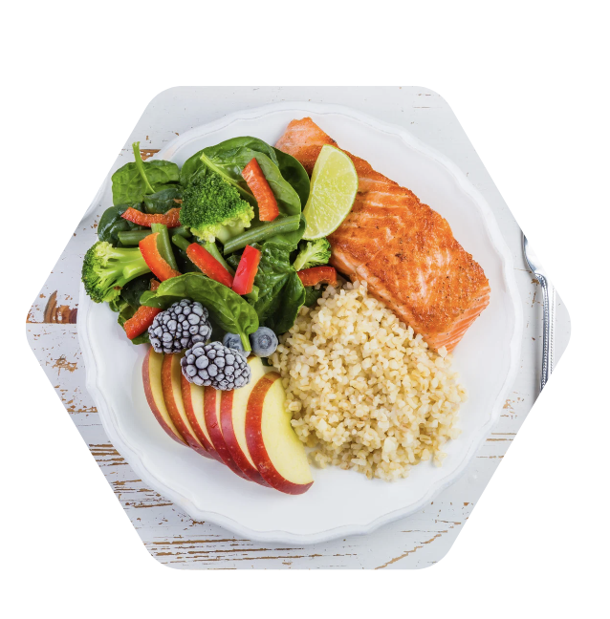
What can We do to help Our body?
GOOD EATING HABITS
Your meal should be 50% Fruits and vegetables
J A M A
The Journal of the American Medical Association
You’re on Doctors’ Order:
“We Recommend
ALL ADULTS to take
vitamin supplements daily”
“RDA of fruits & vegetable is enough to prevent deficiency,
Not enough to prevent disease”

Slide 10
INTRODUCING
VITACEL
FOOD SUPPLEMENTS

Slide 11
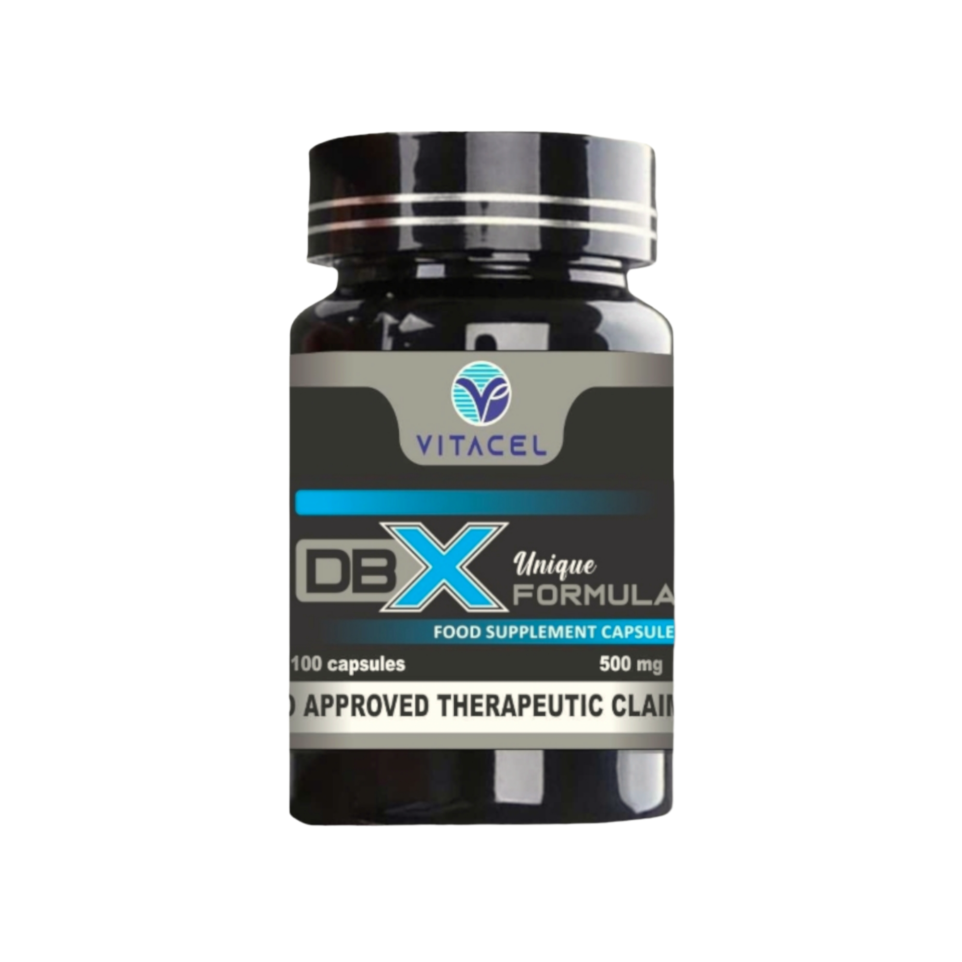
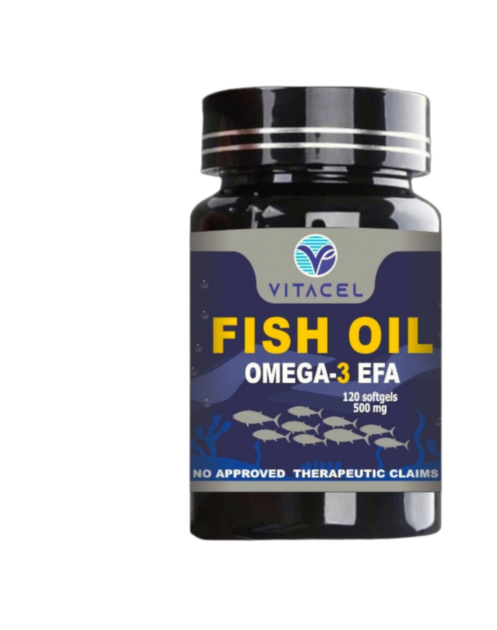
VITACEL
DBX
POWER TRIO
Specially Formulated to address the unique needs of those with DIABETES and HIGH-BLOOD PRESSURE. Also best for WEIGHT LOSS.
VITACEL-C
Supercharge Your Immunity with Vitacel-C, Sodium Ascorbate Non-Acidic Vitamin C.
VITACEL FISH OIL – Omega-3
Provides essential fatty acids that supports heart health, brain functions, eye health and joint mobility.

Slide 12
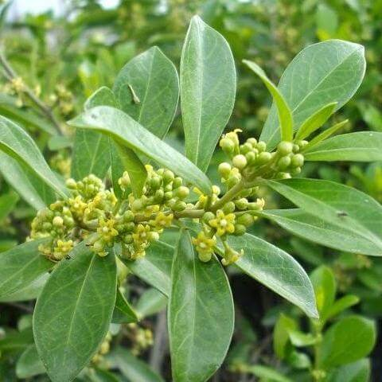
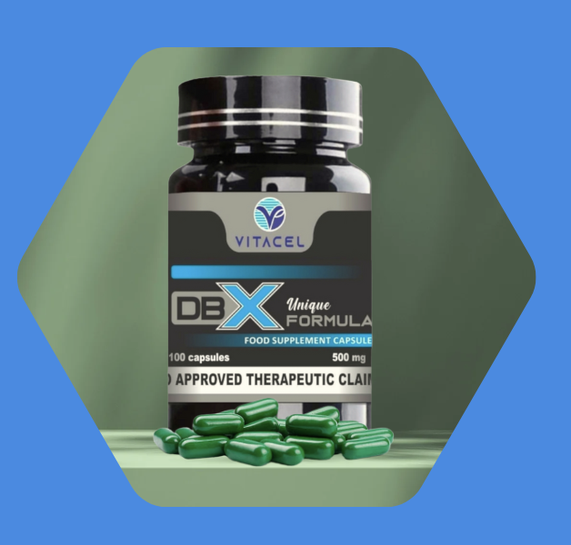
With:
“Gymnema Sylvestre”
also known as
SUGAR DESTROYER
In the Ayurvedic system, it is referred to as “Meshasringa” or “Gurmar” and has indications for use in
glucose balance.
Gymnemic acid—an active component isolated from leaves of G. sylvestre—has antiobesity and antidiabetic properties; it causes decrease in body weight and inhibits glucose absorption.

Slide 13
“Gymnema Sylvestre”
SUGAR DESTROYER
It enhances production or activity of insulin and promotes regeneration of pancreas beta cells.
It Improves glycemic control, reducing hypoglycemic drug needs.
Applied to the tongue, gymnemic acid blocks sensation of sweetness.
Gymnema decreases cravings for carbohydrates and enables patients to follow a lower-carbohydrate diet.
Joseph E. Pizzorno ND, ... Herb Joiner-Bey ND, in The Clinician's Handbook of Natural Medicine (Third Edition), 2016
Mohammad Ali Shariati, ... Chukwuebuka Egbuna, in Preparation of Phytopharmaceuticals for the Management of Disorders, 2021
L.A. Mitscher, in Comprehensive Medicinal Chemistry II, 2007

Slide 14
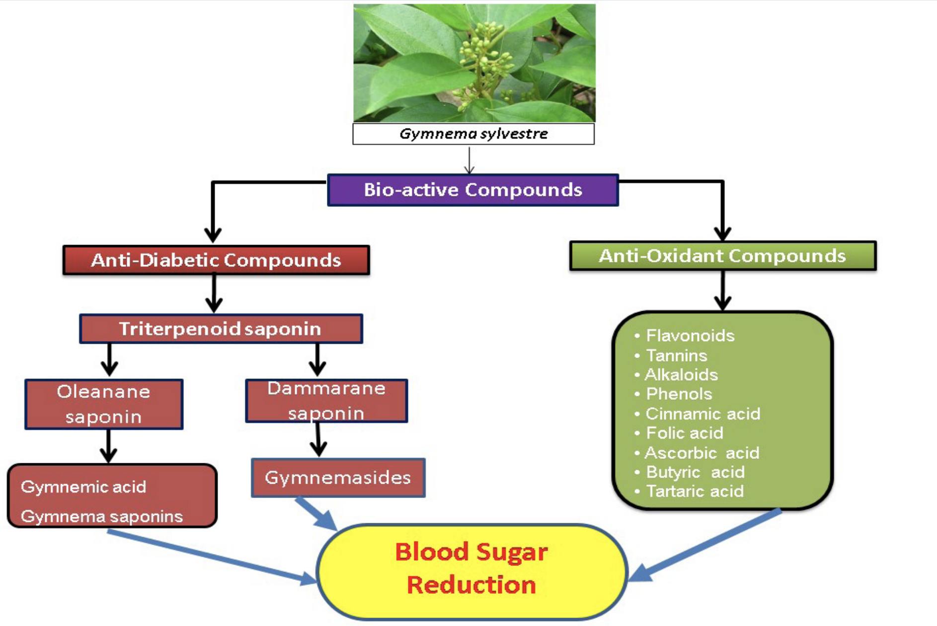
“Gymnema Sylvestre”

Slide 15
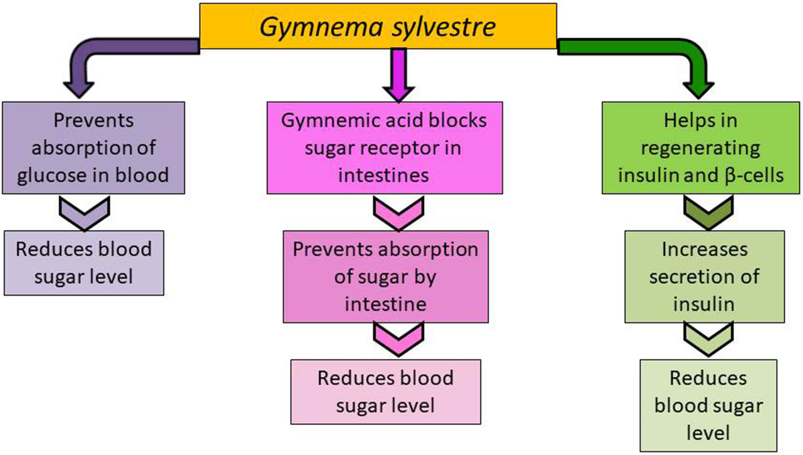
“Gymnema Sylvestre”

Slide 16
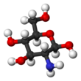
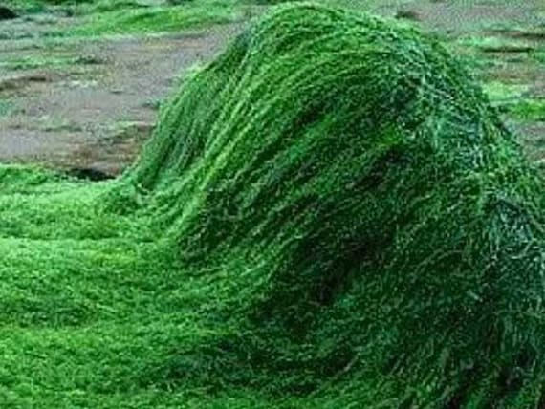
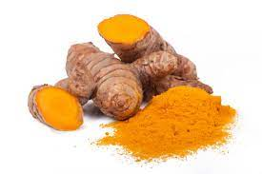
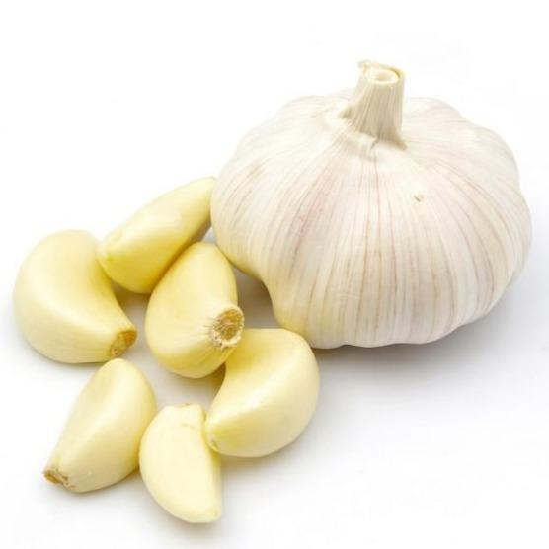
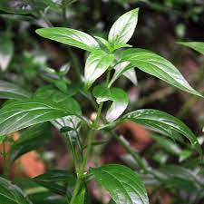
“Gymnema Sylvestre”
Other Ingredients:
GLUCOSAGREENS
SPIRULINA
TURMERIC
GARLIC
SERPENTINA
Specifically formulated to address the unique needs of those with Diabetes and High blood pressure..
BEST FOOD SUPPLEMENT FOR WEIGHT-LOSS and OBESITY. SUPPRESSES APPETITE / CRAVINGS

Slide 17
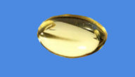
Understanding the Power of Omega-3s
HEART HEALTH
Omega-3 Fish Oil helps reduced rate of heart disease, rheumatoid arthritis and other ailments even though you ate a high-fat and high-cholesterol diet.
It helps to prevent irregular heartbeat, reduce fatty plaques inside artery walls, decrease blood clotting, decrease triglycerides (blood fat), increase HDL (good cholesterol) and decrease inflammation.
Omega-3 Fish Oil helps on reducing the risk of sudden death from heart attack," said Penny Kris Etherton, distinguished professor of nutrition at Pennsylvania State University.

Slide 18
Understanding the Power of Omega-3s
BRAIN HEALTH
Research indicates omega-3s may boost levels of the brain chemicals serotonin and dopamine, decreasing depression and violence.
Omega-3s may even improve conditions such as bipolar disorder and schizophrenia.
"In 5 out of 6 of the clinical trials where people were given either a placebo or omega-3 fatty acids, on average, the symptoms of depression have been reduced by about 50 percent," said Joseph Hibbeln, a psychiatrist at the National Institutes for Alcohol Abuse and Alcoholism.

Slide 19
Other Health Benefits of Omega-3 Fish Oil
Omega-3s may help support bone formation..
Omega-3 may also benefit the skin. ; psoriasis-helps decrease in cell proliferation and skin inflammation.
Omega-3s may help prevent Type 2 diabetes and improve the effects of diabetes by reducing insulin resistance.
The U.S. Food and Drug Administration recently approved omega-3s for infant formulas because of the overwhelming evidence that it improves cognition and visual functioning in children.
Inflammatory diseases such as rheumatoid arthritis, ulcerative colitis and Crohn's disease may also improve with omega-3 supplementation.

Slide 20
Boosts Immune System
Supports Collagen Production
Potent Antioxidant
Enhances Iron Absorption
Supports Skin Health
Enhances Omega-3 Absorption
Vitamin C is known to improve the absorption of various nutrients, including omega-3 fatty acids from fish oil. By taking Vitamin C with your omega-3 supplement, you may increase the body's ability to absorb and utilize the beneficial fatty acids efficiently.

Slide 21
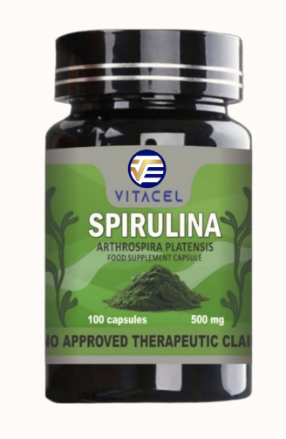
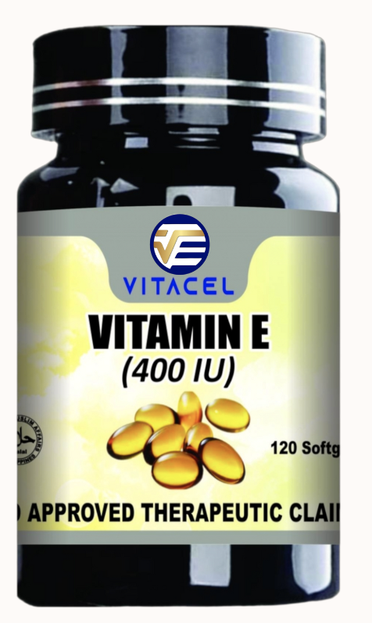
OTHER PRODUCTS
Anti-inflammatory
Relieves Arthritis
Anti-cancer effect
Prevents heart disease
Improves mood
Super Food
Antioxidant
Anti-cancer
Anti-tumor
Anti-ageing
Weight Loss
Master Anti-oxidant
Detoxify the liver
Whitens the skin
Increase Energy
Boosts Immunity
Anti-ageing
Restores the Skin
Prevents Cancer
Prevents hair loss
Eye Health
Boosts Immunity
Heart Health

Slide 22
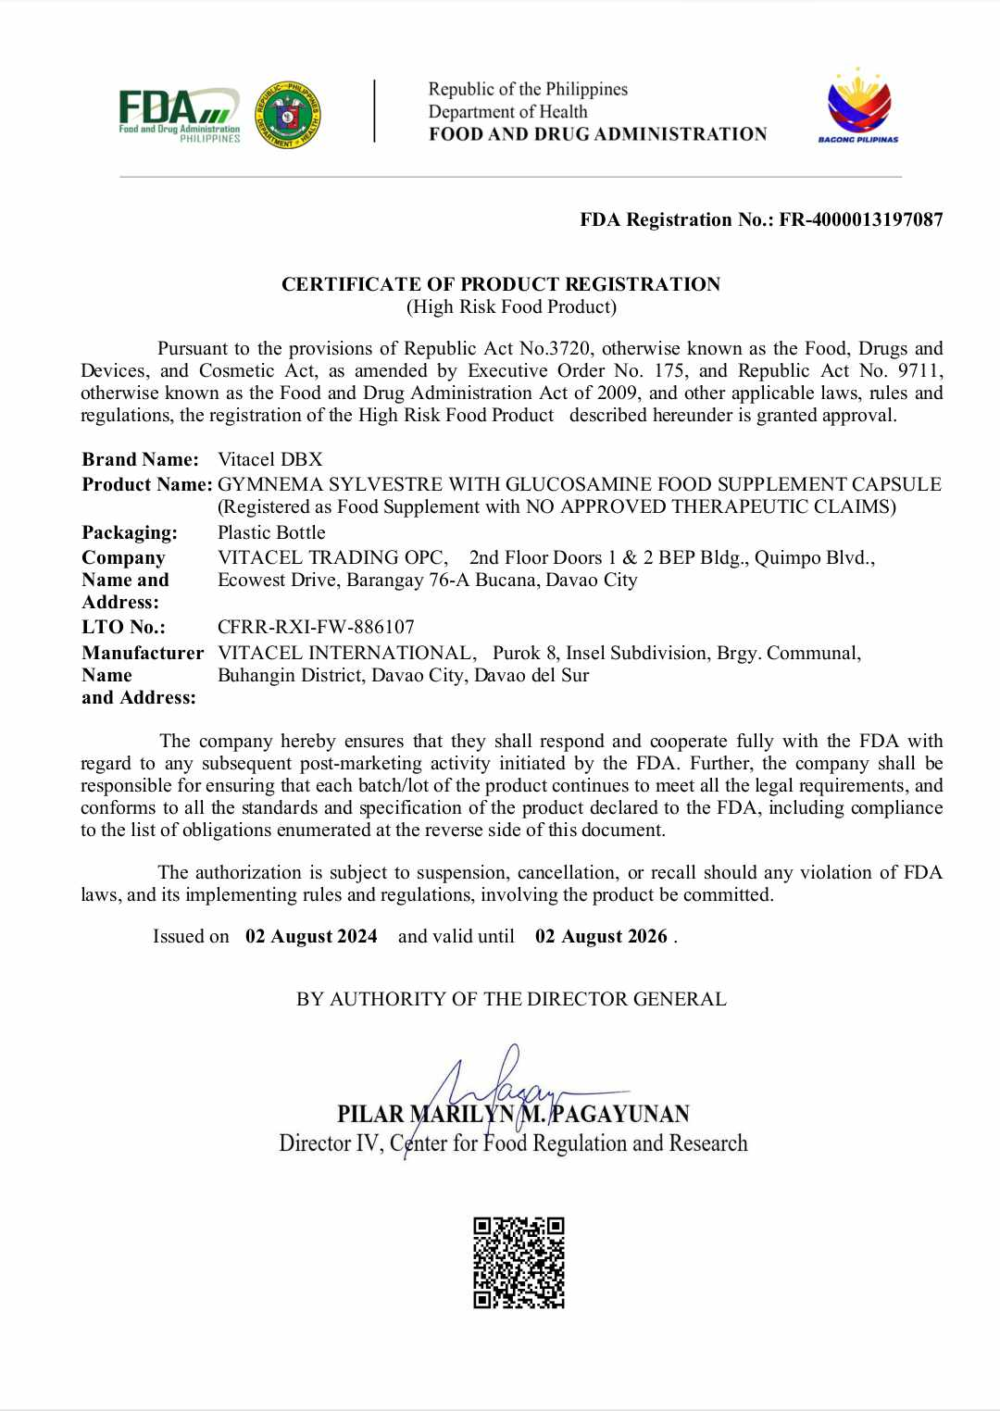
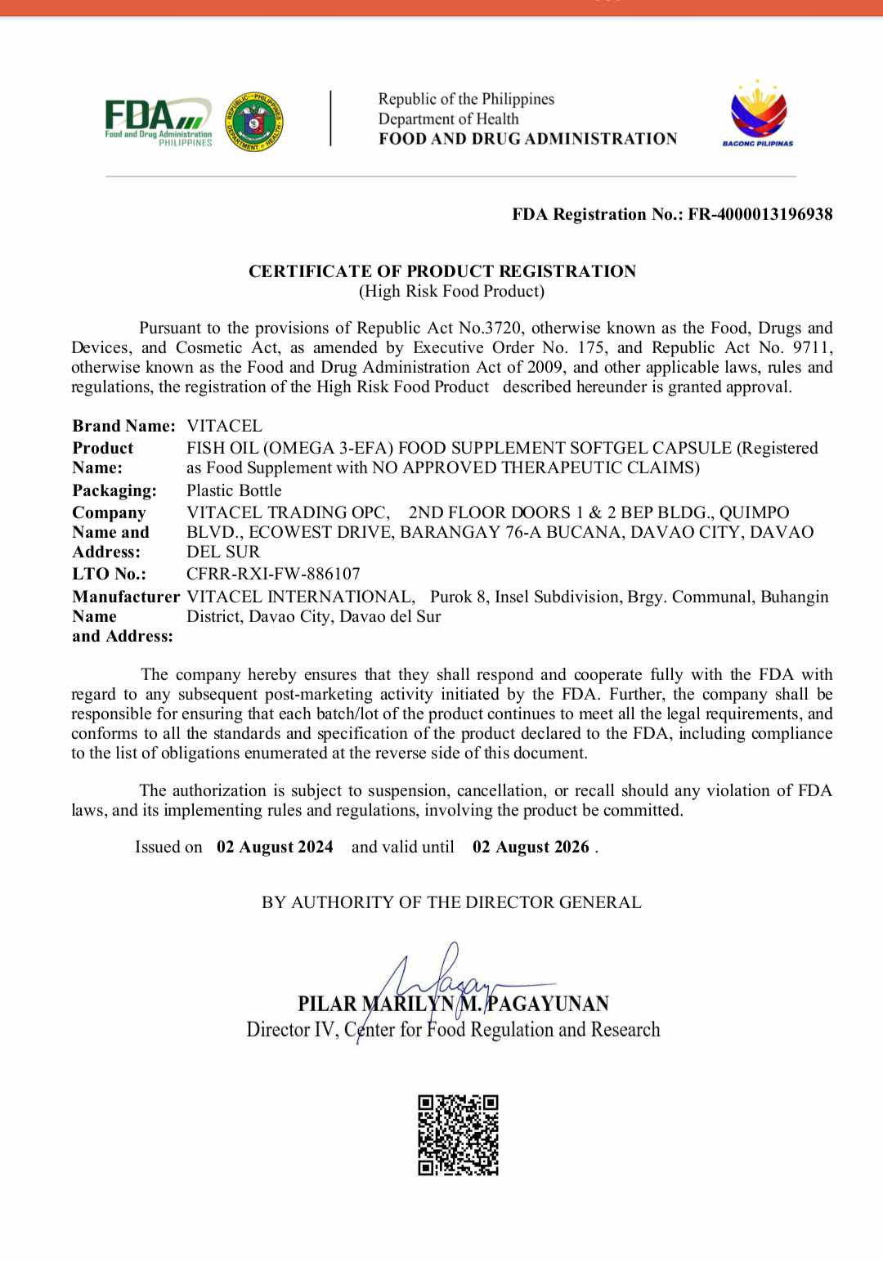
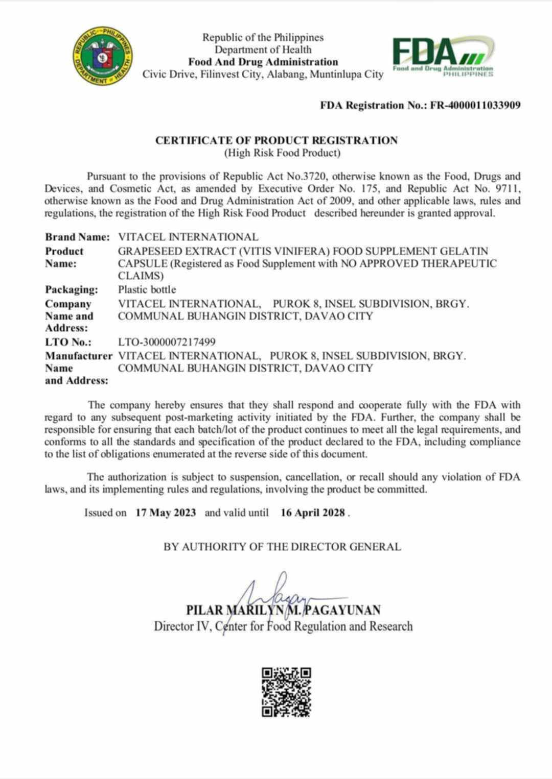
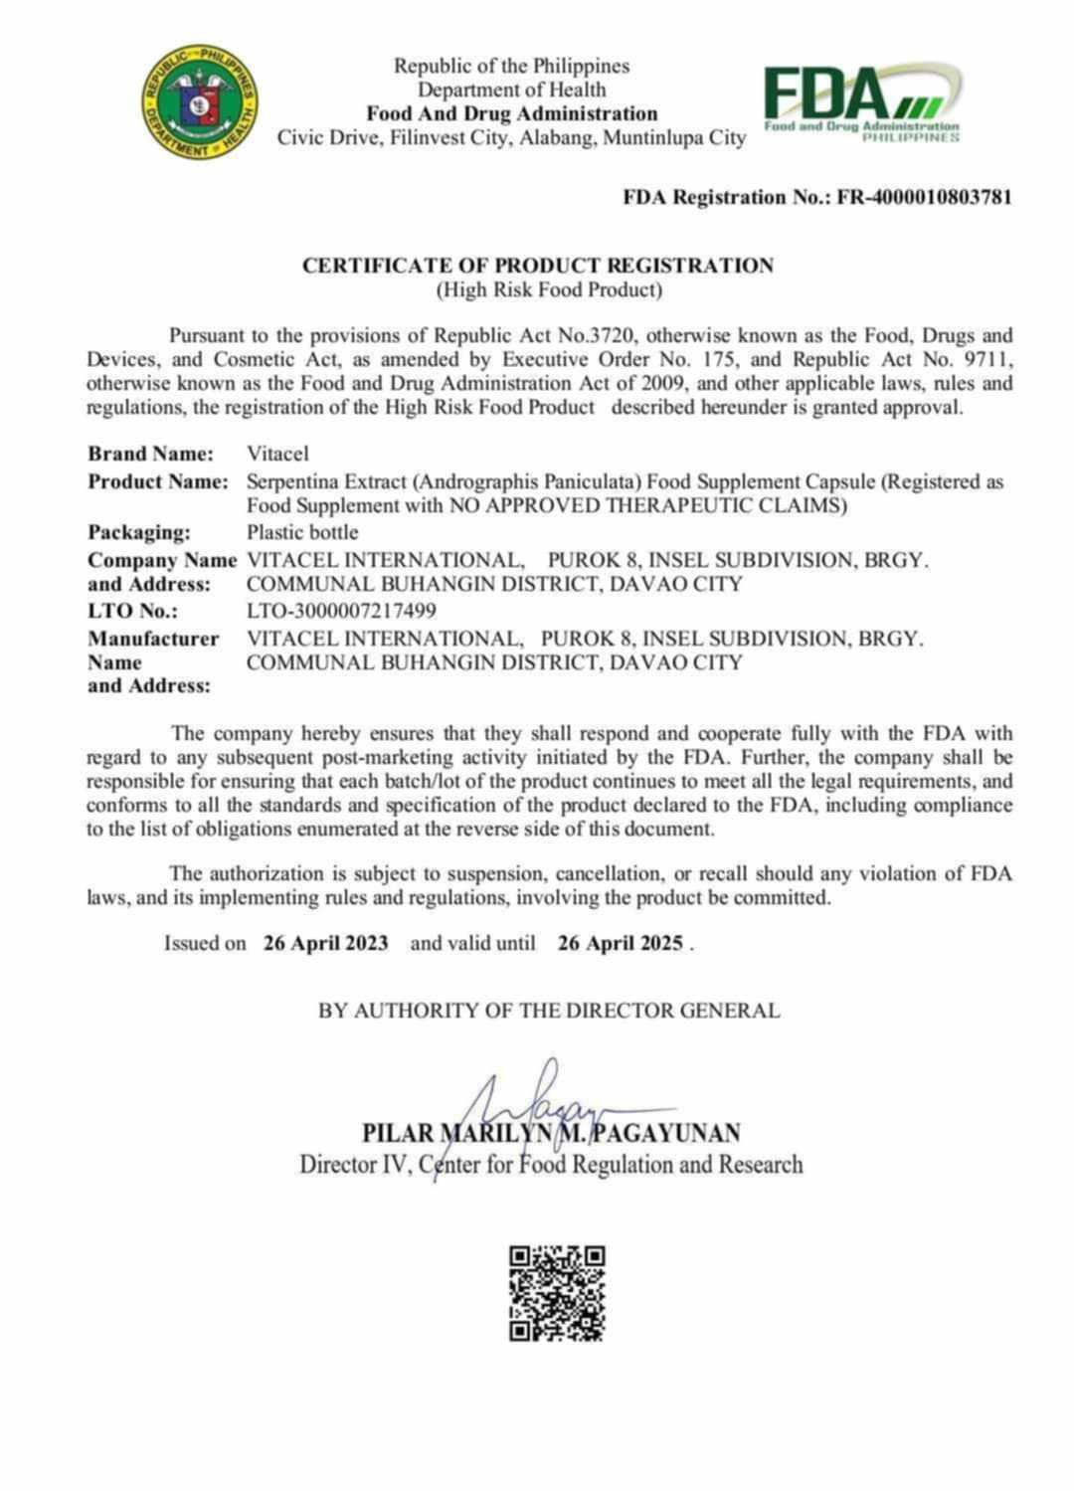
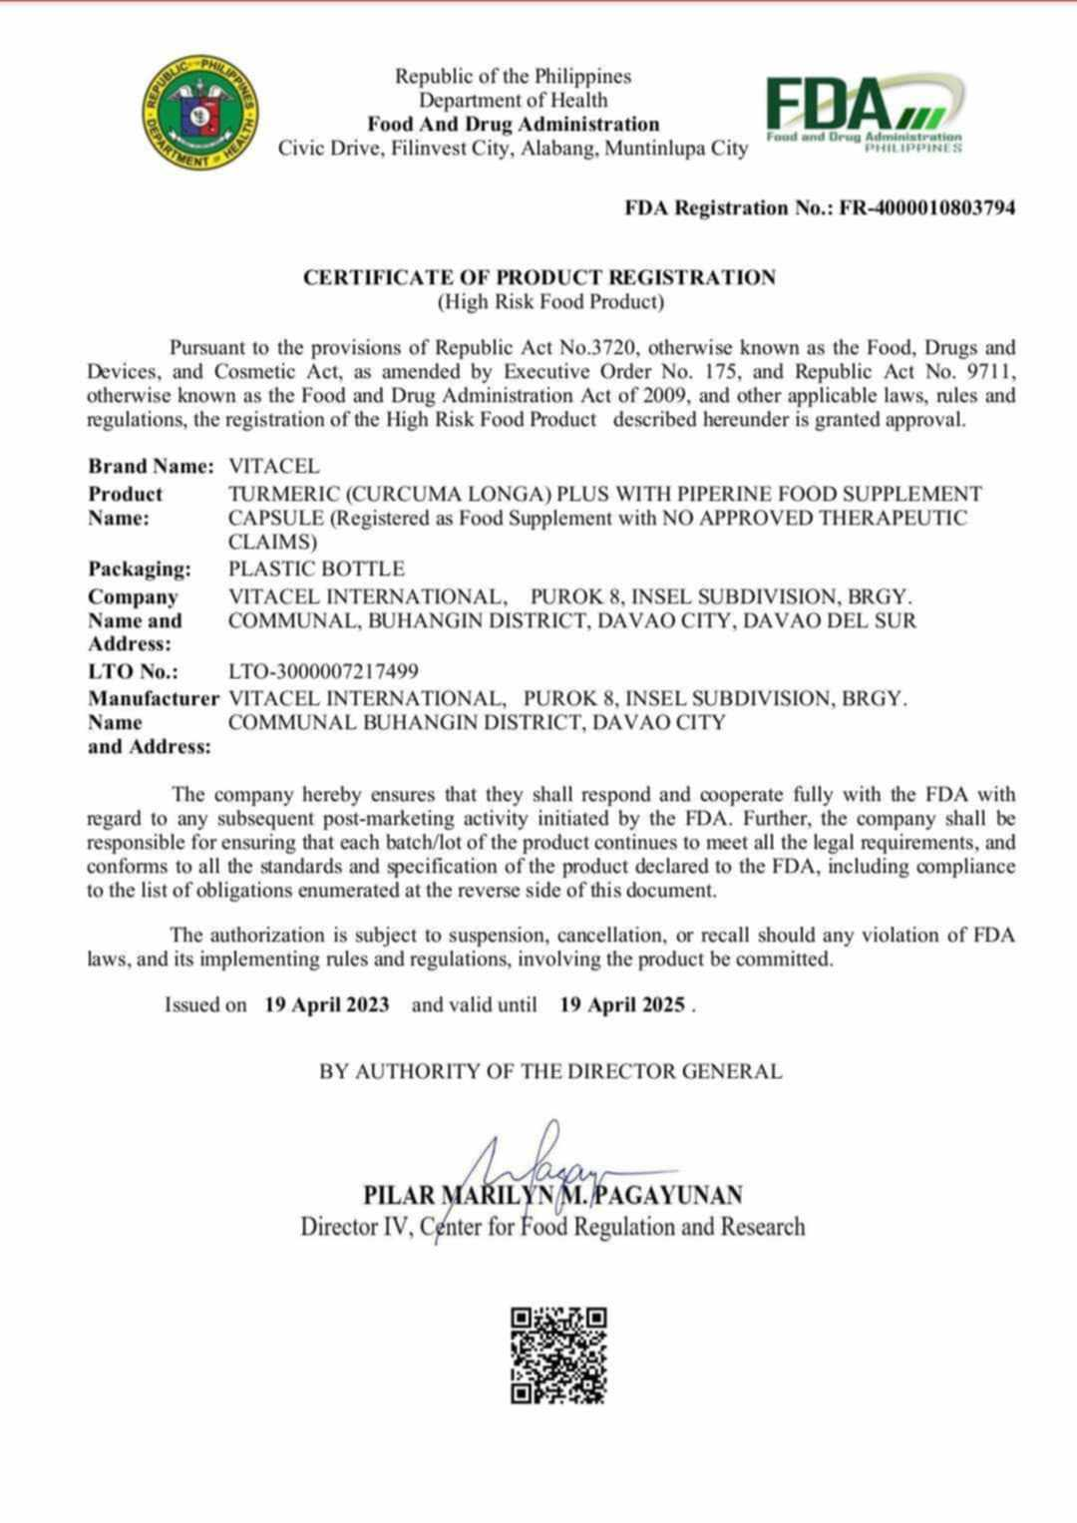
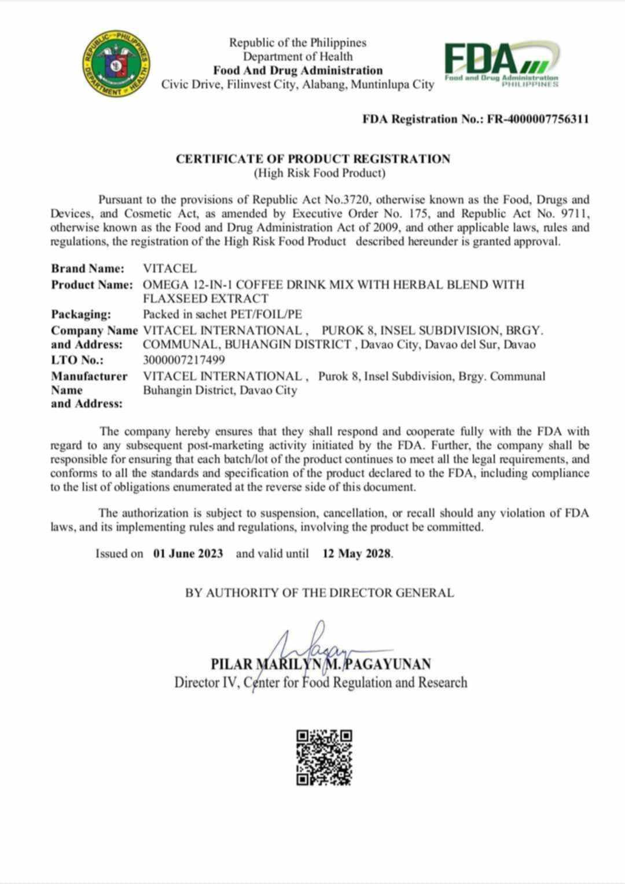
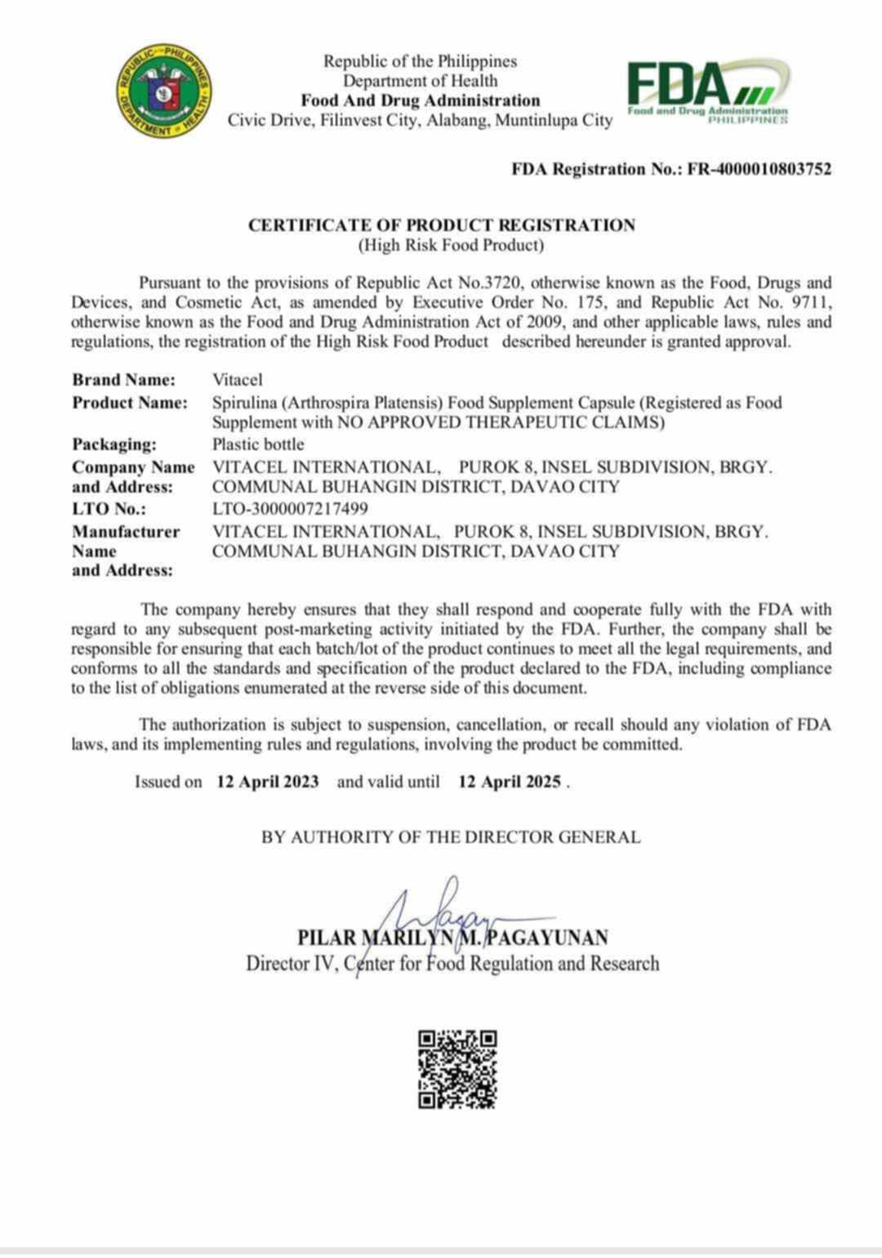

Slide 23
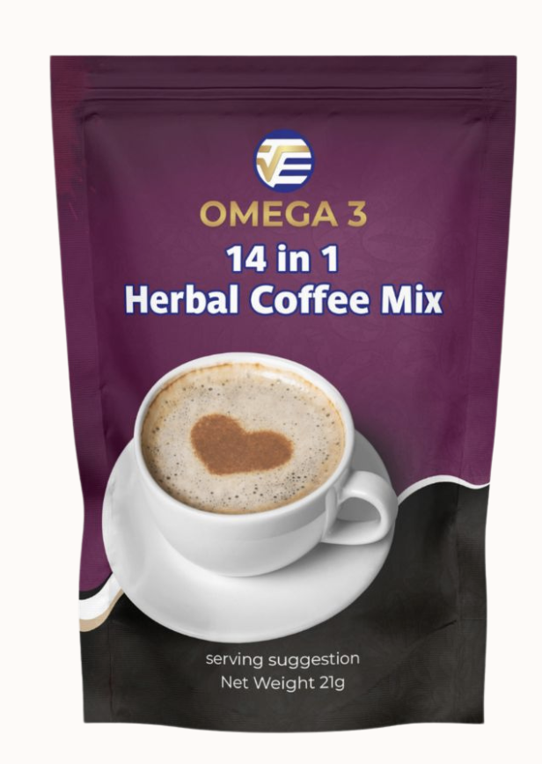
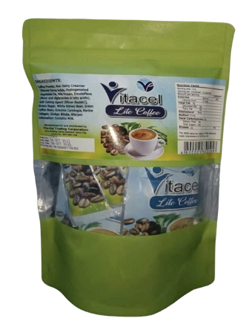
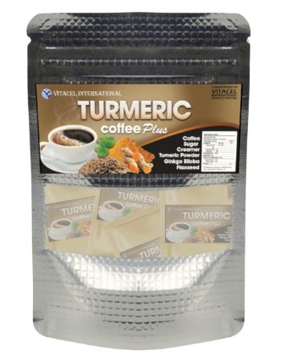
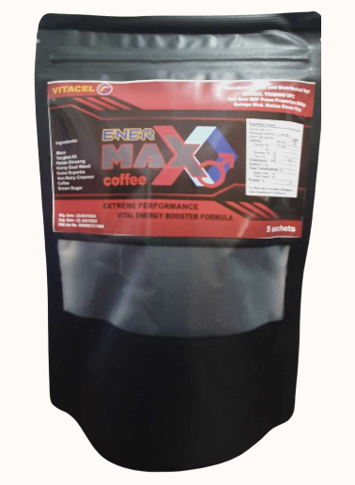
VITACEL HERBAL COFFEE
Rich in Antioxidant
Relieves Arthritis
Anti-ageing
Anti-cancer effect
Heart Health
Improves Sleep
Anti-Inflammatory
Antioxidant
Relieves Arthritis
Boosts Memory
Weight Loss
Increase Energy
Weigh Loss
Suppress Appetite
Improves Digestion
Increase Energy
Boosts Immunity
Anti-ageing
Enhance Fertility
Improves Testosterone Level
Increases Libido
Boosts Energy
Boosts Immunity

Slide 24
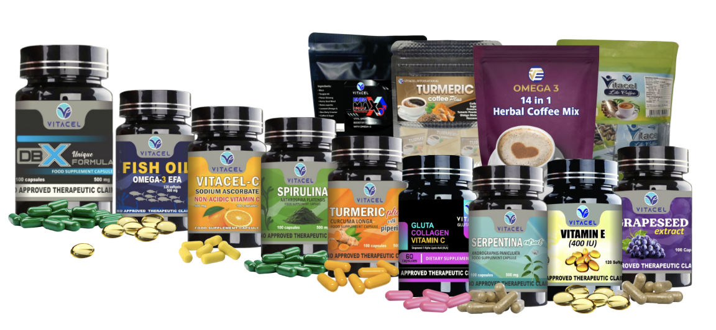
“With a Very good Quality Products,
Great business Opportunity awaits!”

Slide 25
VITACEL
MARKETING PLAN
PRESENTATION
SUSTAINABLE BUSINESS MODEL
PROFITABLE CONSUMERISM

Slide 26
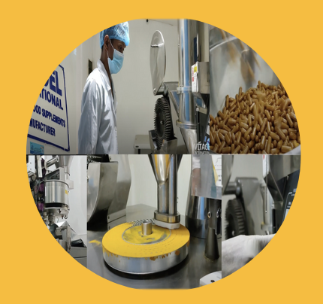
WHY VITACEL?
Health and Wellness
Company Owned Manufacturing
Low Start-Up Capital
Relevant Product
YOU are the BOSS
Time Freedom
Leverage on other People
Doable and Duplicable System
Portable
Pandemic Proof Business

Slide 27
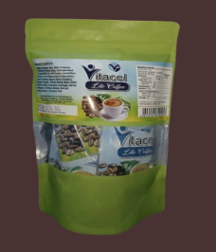
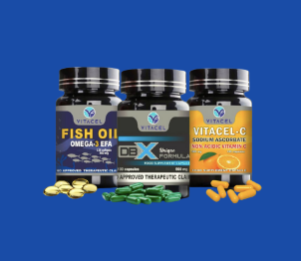
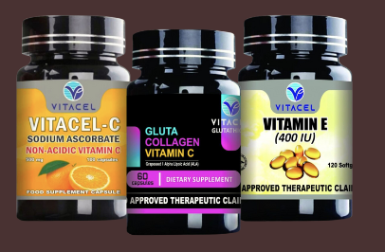
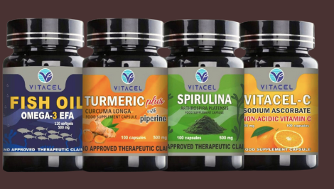
CHOOSE YOUR VITACEL PACKAGE
PREMIUM
GOLD
DIAMOND
P4,980
P14,940
P34,860
P5,300+ Product Value
1 Business Account= 1 Pt.
P315,000 monthly income Potential
P16,000+ Product Value
3 Business Accounts= 3 Pts.
P945,000 monthly income Potential
P37,100 + Product Value
7 Business Accounts= 7 Pts.
P2,205,000 monthly income Potential

Slide 28
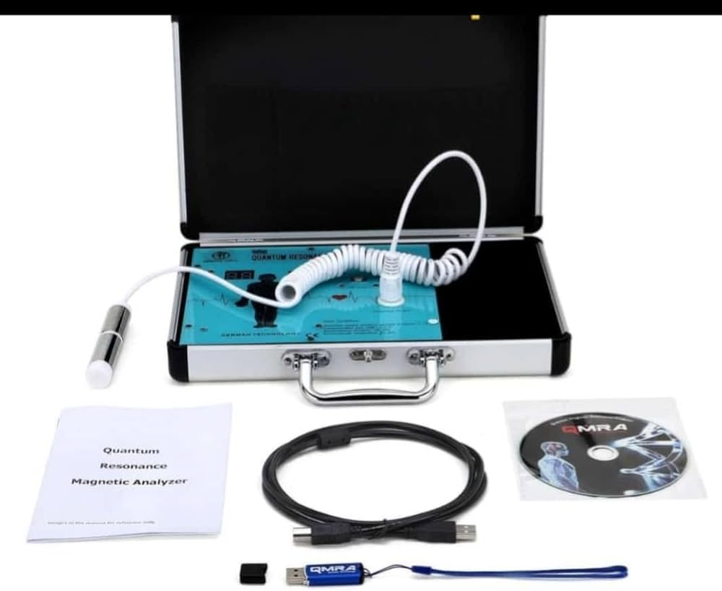
BUSINESS PACKAGE
PLATINUM
Capital: P75,000
Worth of Products P 80,000
Plus: QMRA Machine
5% Product Discount on Repeat Purchase
P4,725,000 monthly potential income

Slide 29
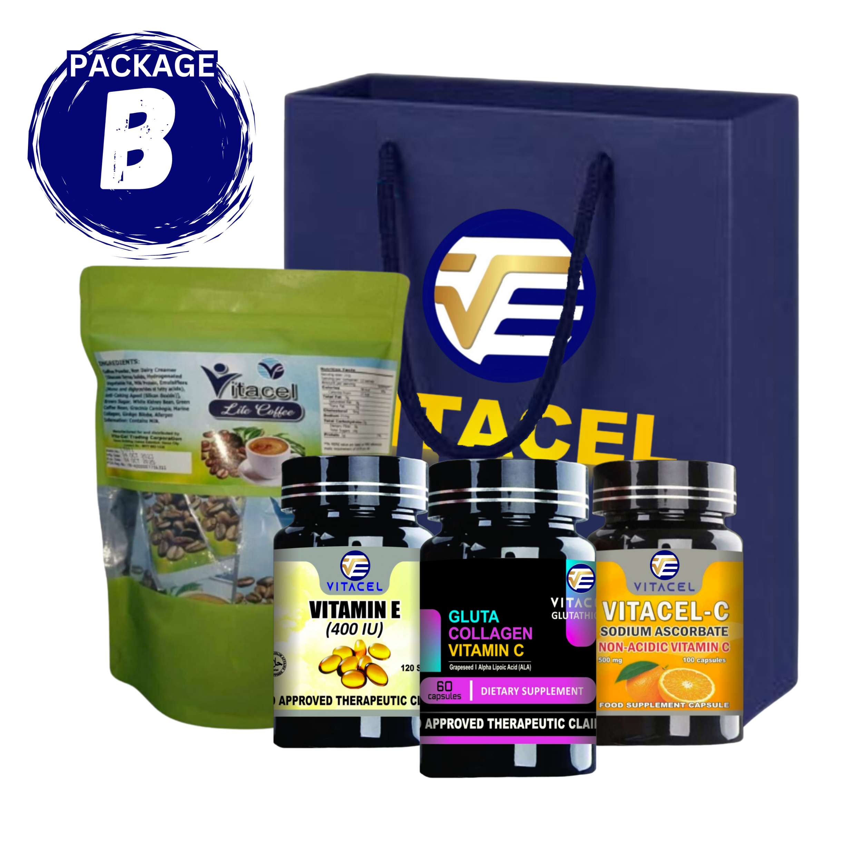
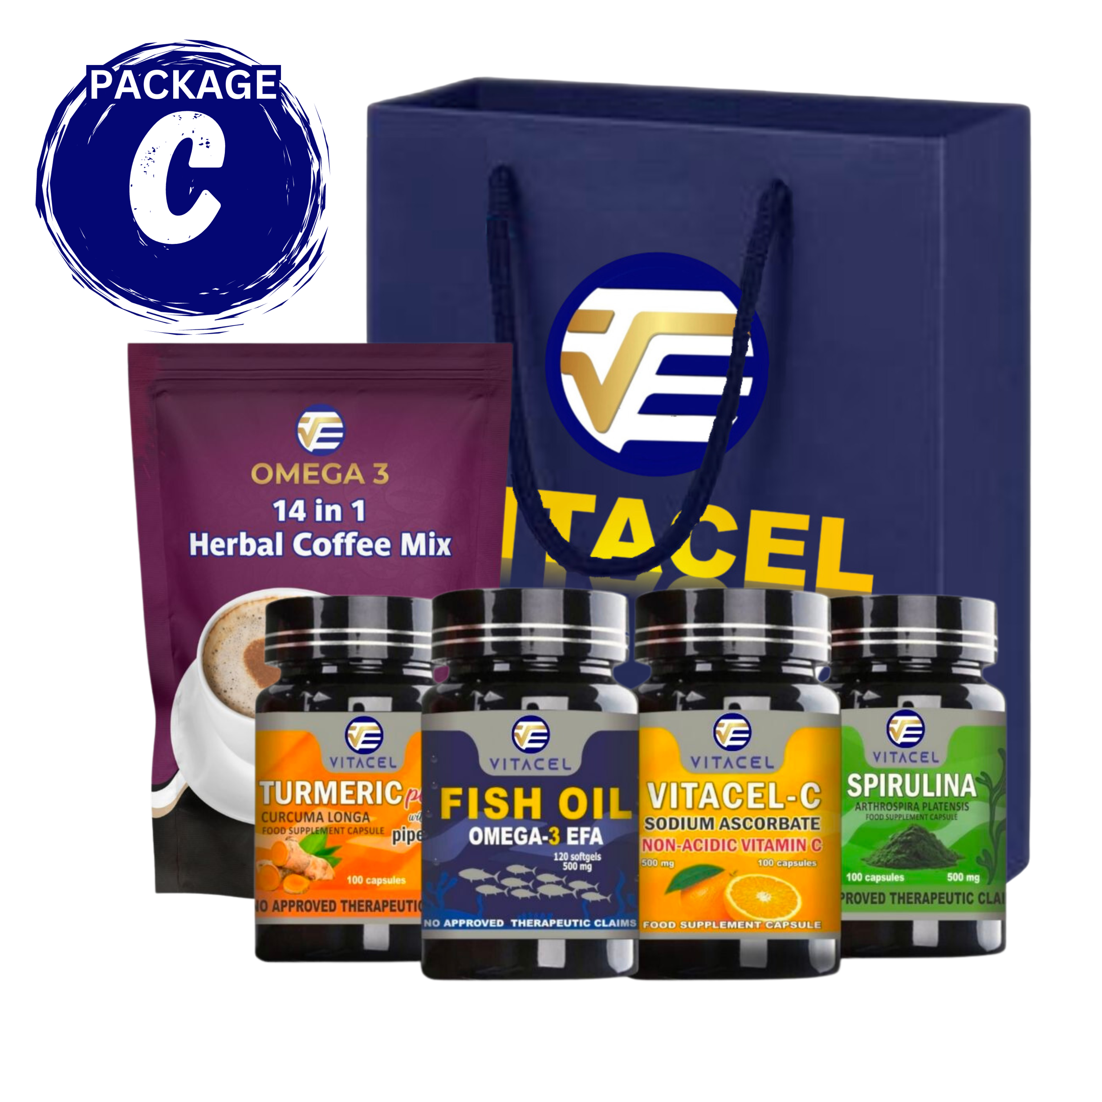
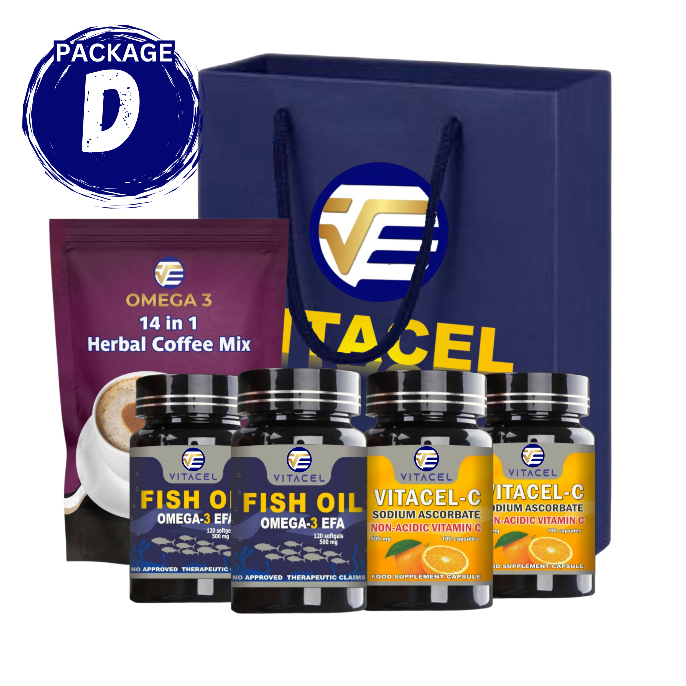
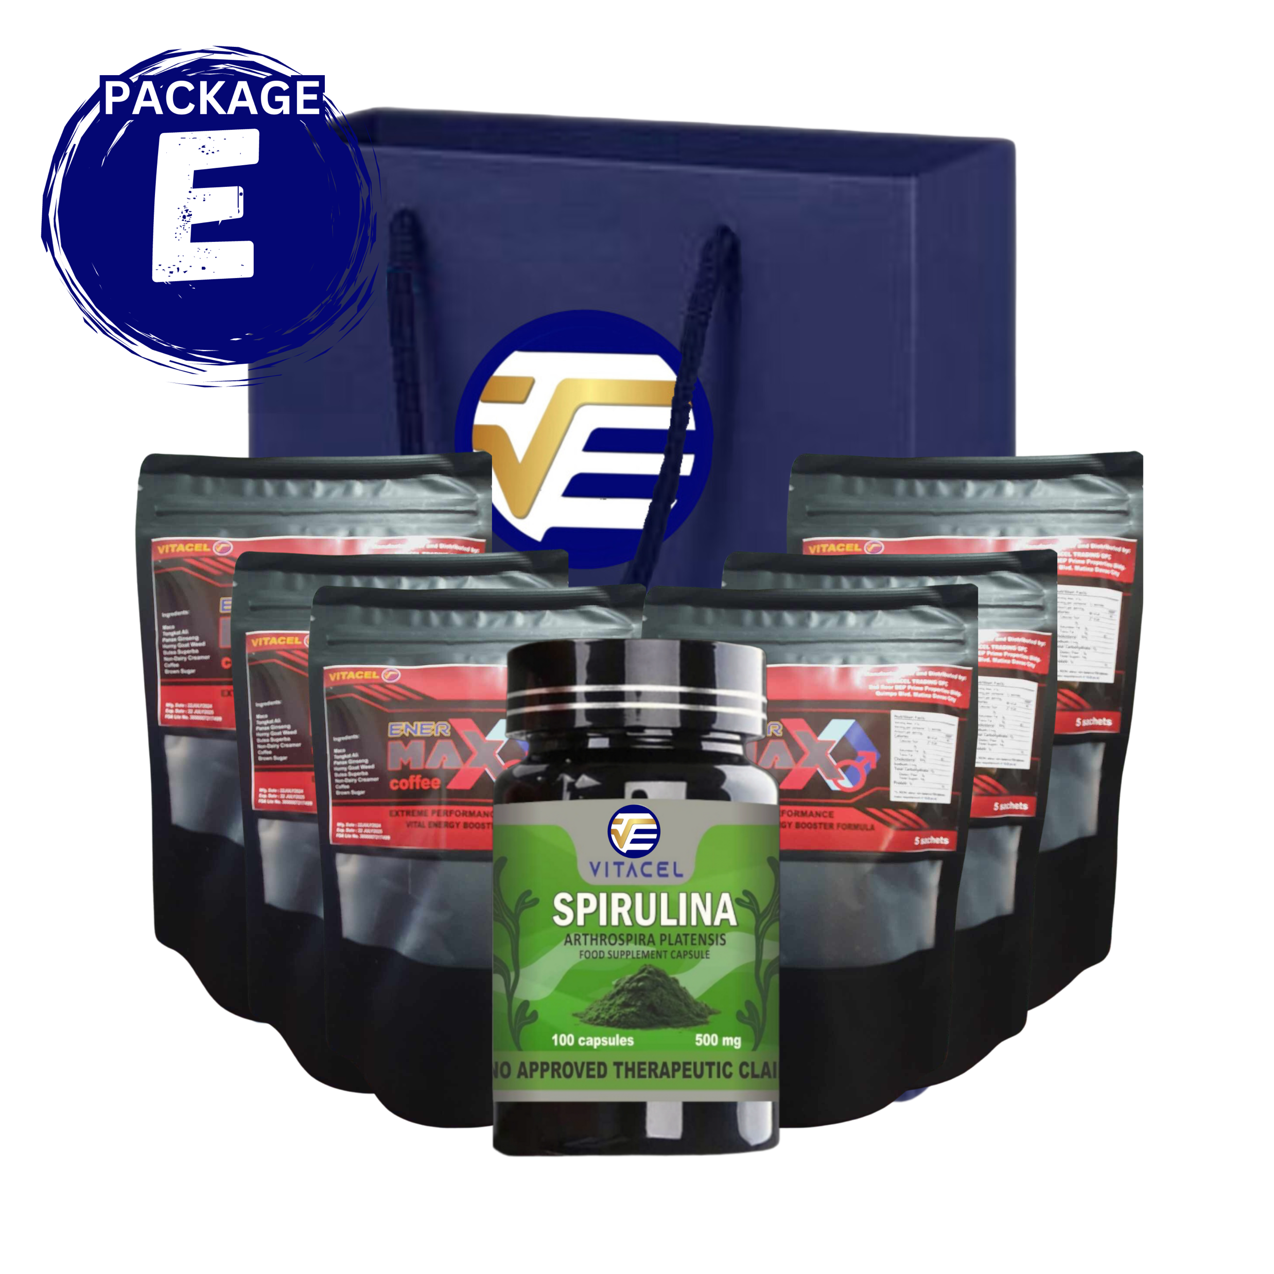
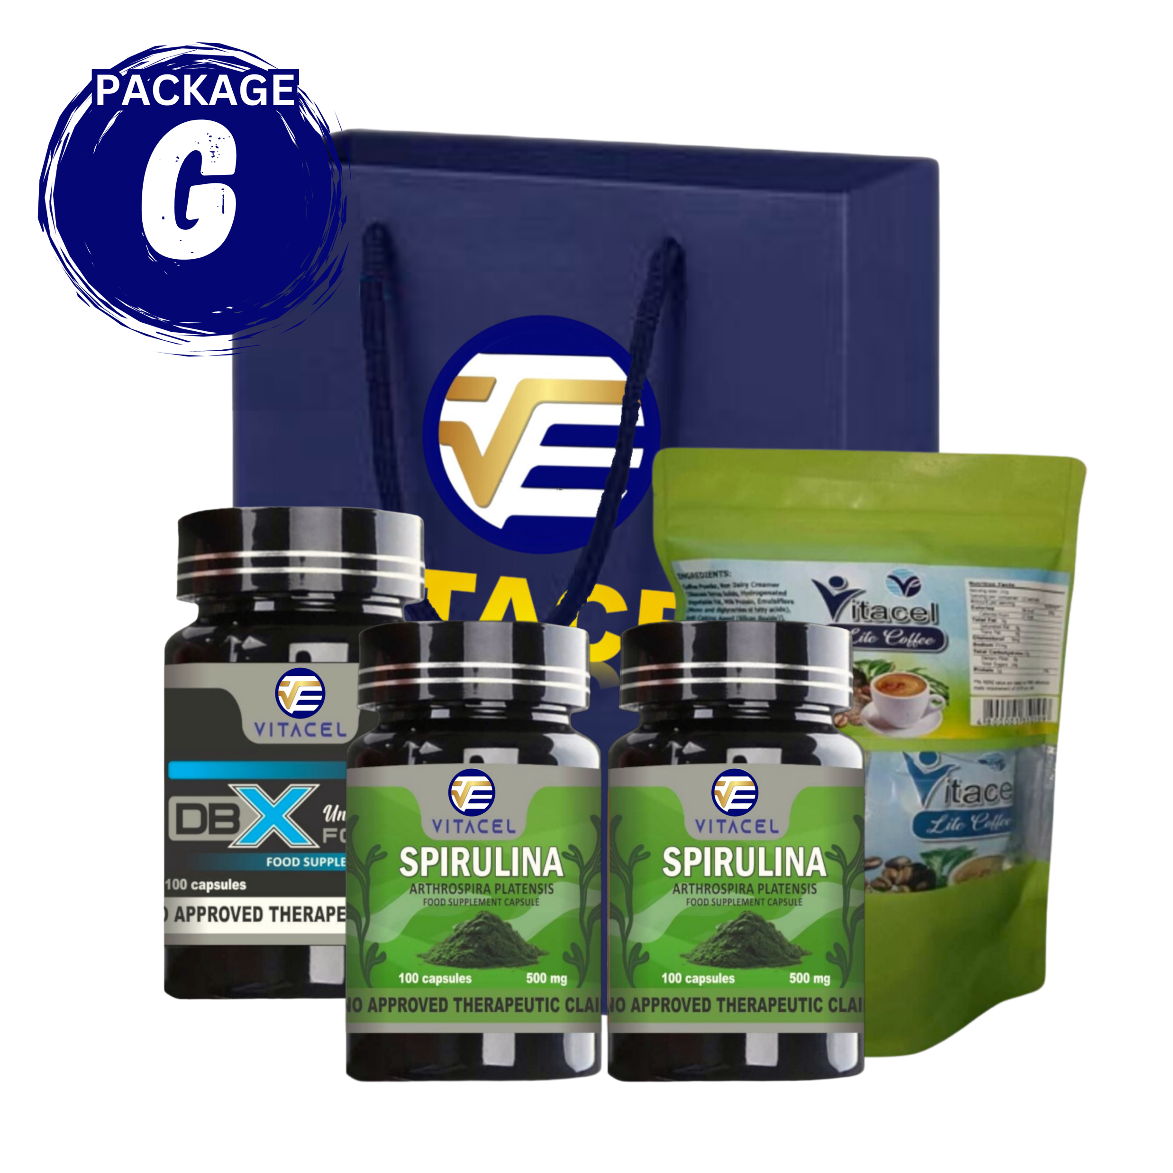
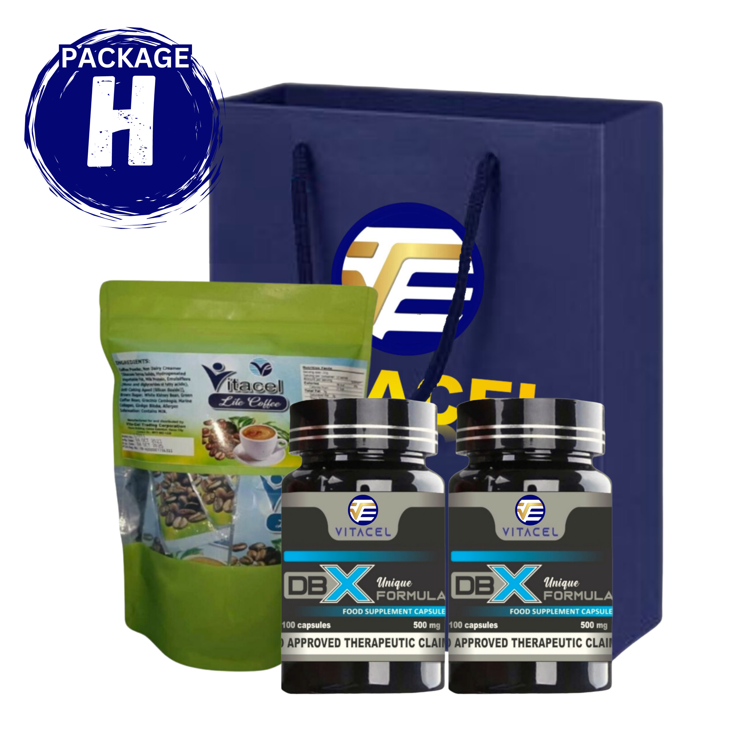
CHOOSE YOUR VITACEL PACKAGE

Slide 30
BENEFITS:
Health and Wellness Products
40% Lifetime Discounts
Lifetime Business
Online Tracking Website
Personal & Group Commissions
Free Trainings & Seminars
Free Check-up & Health Consultations
Raffles and Giveaways
Cars and Travel Incentives

Slide 31
6 Ways To Earn
1
DIRECT SELLING
2
DIRECT REFERRAL BONUS
3
SALES MATCH BONUS
4
UNILEVEL BONUS
5
RANKS & INCENTIVES
6
RAFFLE & GIVEAWAYS

Slide 32
1
DIRECT SELLING
30% TO 40% Product Discounts
Customers Price: P420
Customers Price: P2,500
Distributors Price: P270
Distributors Price: P1,500
Profit: P150
Profit: P1,000

Slide 33
2
DIRECT REFERRAL BONUS
YOU can sponsor/refer as many as you can…
YOU
P500
P1,500
P3,500
P7,500
PREMIUM
P4,980
GOLD
P14,940
DIAMOND
P34,860
PLATINUM
P75,000

Slide 34
3
SALES MATCH BONUS
Point System Binary = Match Bonus is given based on the Points in every Product Package Purchased. [ 1 : 1 ] = P700
PREMIUM
1 Pt.
GOLD
3 Pts.
DIAMOND
7 Pts.
15 Pts.
PLATINUM

Slide 35
3
SALES MATCH BONUS
Left Group
Right Group
YOU
P500
P500
1
Point
P700
1
Point
Alan
Ben
PREMIUM
PREMIUM
6 x 700
P4,200
6
Points
Carl
Dina
Eden
Fely
P1,500
GOLD
P2,100
P1,500
GOLD
P3,500
DIAMOND
P4,900
DIAMOND
P3,500
7
Points
7
Points
3
Points
3
Points
1
Point
7
Points
7
Points
P4,900
8
Point
Gino
1
Point
P700
1
Point
P3,500
DIAMOND
PREMIUM
P10,500
15
Points
15
Points
PLATINUM
PLATINUM

Slide 36
3
SALES MATCH BONUS
Maximum Potential Income
PREMIUM
GOLD
DIAMOND
PLATINUM
P4,980
P14,940
P34,860
1 Business Account
P10,500 per Day
P73,500 per Week
P315,000 per Month
3 Business Accounts
P31,500 per Day
P220,500 per Week
P945,000 per Month
7 Business Accounts
P73,500 per Day
P514,500 per Week
P2,205,000 per Month
15 Business Accounts
P157,500 per Day
P1,102,,500 per Week
P4,725,000 per Month

Slide 37
DIAMOND PACKAGE
CAPITAL =
P34,860
Potential Income:
P2,205,000 /month
FAST TRACK RESULT: POWER OF 8
7 – BUSINESS ACCOUNTS
*Your Goal is to Direct Sponsor 8 Diamond Packages, and “DUPLICATE”
Direct Referral
Bonus
Sales Match
Bonus
Total
Commissions
P3,500
P3,500
P3,500
P3,500
P3,500
P3,500
P3,500
P3,500
P28,000
P53,900
P81,900
8
8
8
8
8
8
8
8
P431,200
P431,200
64
64
64
64
64
64
64
64
P3,449,600

Slide 38
4
UNI-LEVEL BONUS
Earn 10% commission on your total Group Product Points Value (P.V.)
YOU
Levels
TOTAL DOWNLINES
250 PV
MonthLY
10% Commission
1st
2nd
3rd
4th
5th
6th
7th
8th
9th
5
25
125
625
3,125
15,625
78,125
390,625
1,953,125
1,250
6,250
31,250
156,250
781,250
3,906,250
9,531,250
97,656,250
488,281,250
₱ 125
₱ 625
₱ 3,125
₱ 15,625
₱ 78,125
₱ 390,625
₱ 953,125
₱ 9,765,625
₱ 48,828,125

Slide 39
5
RANKS & INCENTIVES
30 Direct Referrals
GPV=5,200,000
2 Crown Diamonds
4 Diamond Executives
ROYAL CROWNED
DIAMOND
25 Direct Referrals
GPV=1,300,000
2 Diamond Executives
4 Gold Executives
CROWNED
DIAMOND
20 Direct Referrals
GPV=325,000
4 Gold Executives
or 2 Golds and
8 Executive Directors
DIAMOND
EXECUTIVE
15 Direct Referrals
GPV=83,750
4 Exc. Directors
GOLD
EXECUTIVE
EXECUTIVE
DIRECTOR
10 Dir. Referrals
GPV=22,500
4 Directors
7 Dir. Referrals
GPV=6,750
4 Builder
DIRECTOR
BUILDER
DISTRIBUTOR
5 Dir. Referrals
GPV=1,250
UNRANK
Referral Bonus: P10,000
Sales Match Bonus: P448,000
Unilevel monthly income: P32,500
Referral Bonus: P15,500
Sales Match Bonus: P4,620,000
Unilevel monthly income: P520,000
Referral Bonus: P2,500
Sales Match Bonus: P1,400
Unilevel monthly income: P125
Referral Bonus: P12,500
Sales Match Bonus: P1,344,000
Unilevel monthly income: P130,000
Referral Bonus: P3,500
Sales Match Bonus: P7,000
Unilevel monthly income: P675
Referral Bonus: P5,000
Sales Match Bonus: P28,000
Unilevel monthly income: P2,250
Referral Bonus: P7,500
Sales Match Bonus: P112,000
Unilevel monthly income: P8,375

Slide 41
5
CAR & TRAVEL INCENTIVES

Slide 42
6
RAFFLES & GIVEAWAYS
1. By Purchasing any Vitacel products you will get a Raffle Code, and get a chance to WIN Raffle Prices. 2. Select/Pick your lucky number, register your name and address on the Vitacel Raffle website. 3. Entry your Raffle code - click submit.

Slide 43
7
STOCKIST CENTER
MINDANAO
VISAYAS
DAVAO CITY
DIGOS CITY - DAVAO DEL SUR
PANABO CITY - DAVAO DEL NORTE
STO, TOMAS - DAVAO DEL NORTE
TAGUM CITY - DAVAO DEL NORTE
MAWAB - DAVAO DE ORO
IPIL – ZAMBIANGA SIBUGAY
PAGADIAN CITY
LUZON
STOCKIST CENTER- HUB
P350,000

Slide 44
VITACEL
Thank You
For Your Attention
Visit Our Website
myvitacel.com

